Slide 1
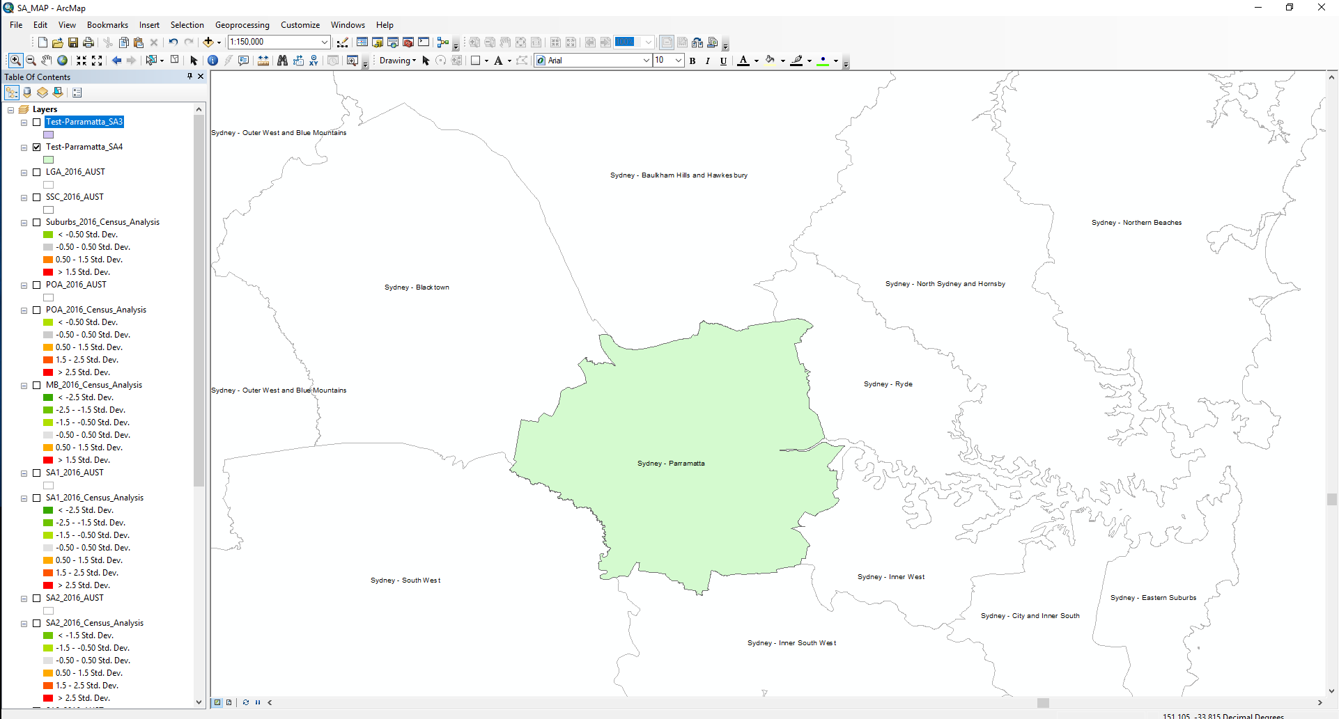
This is the SA4 of Sydney - Parramatta

Slide 2
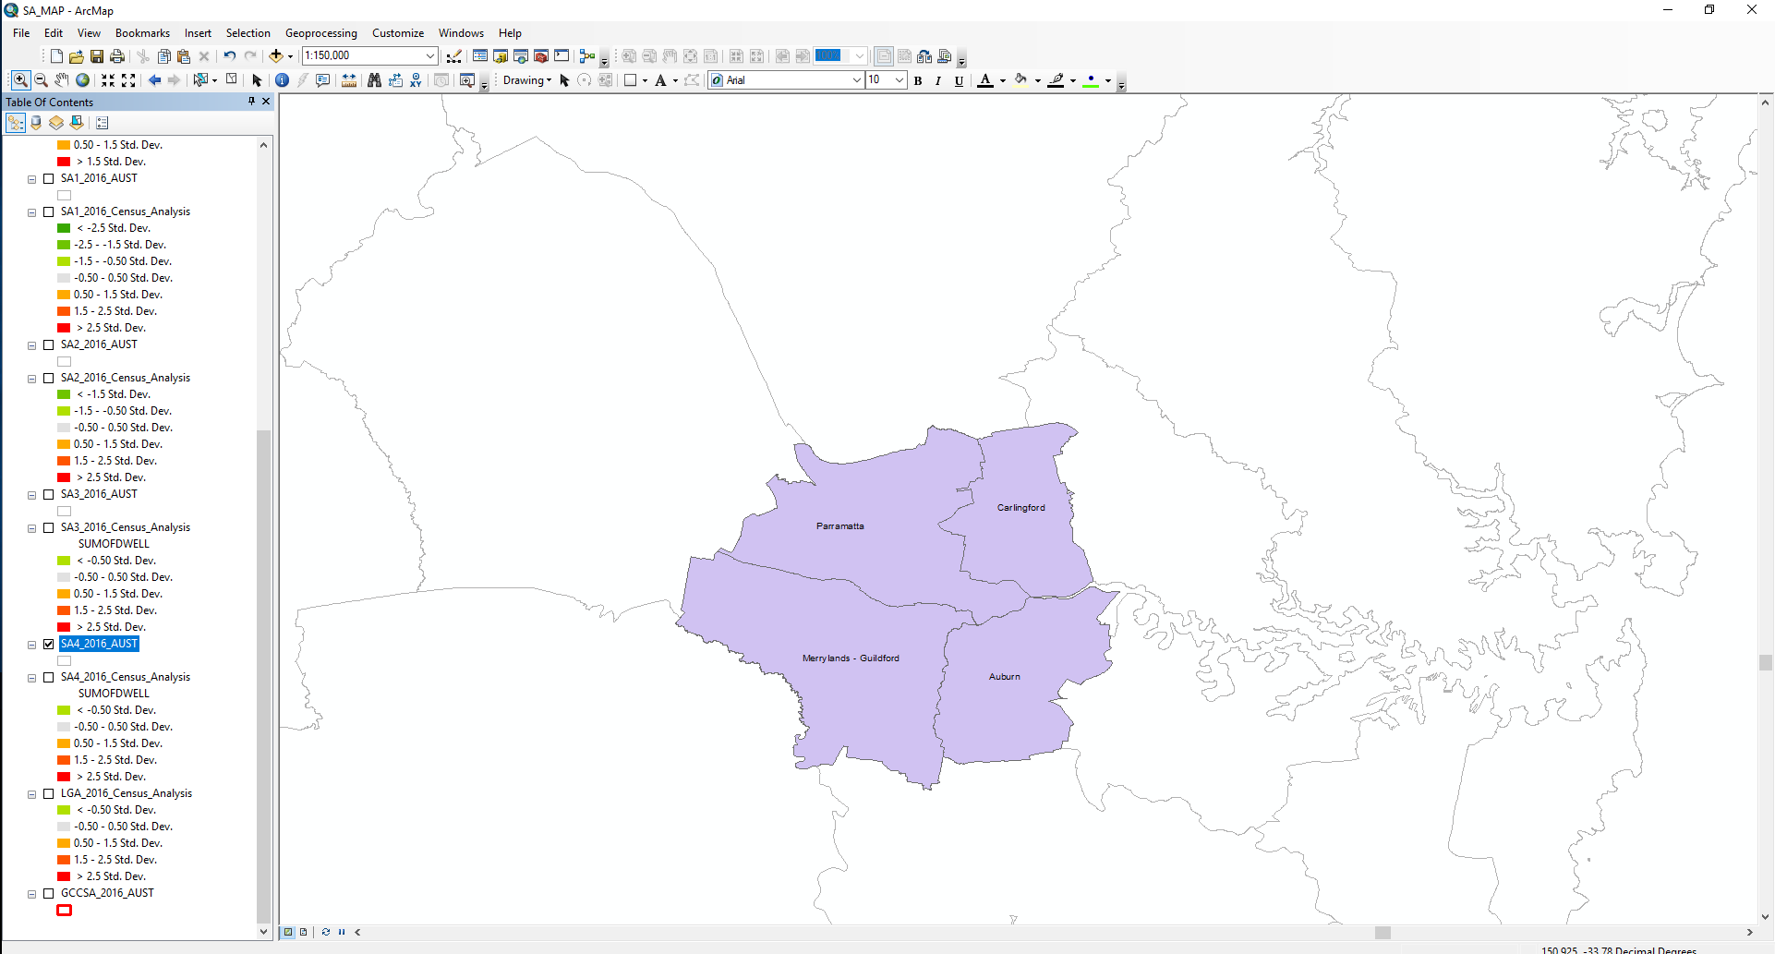
These are the SA3’s in the SA4 of Sydney - Parramatta

Slide 3
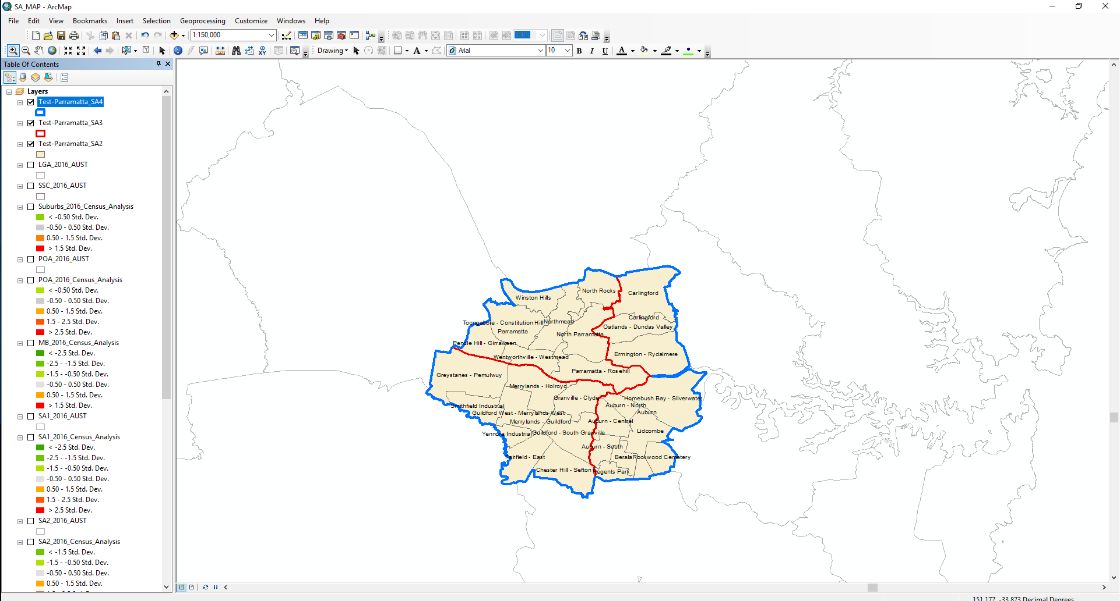
These are the SA2’s in the SA4 of Sydney - Parramatta
SA2’s
SA4 boundary
SA3 boundary

Slide 4

These are the SA1’s in the SA4 of Sydney - Parramatta
SA1’s
SA4 boundary
SA2 boundary

Slide 5
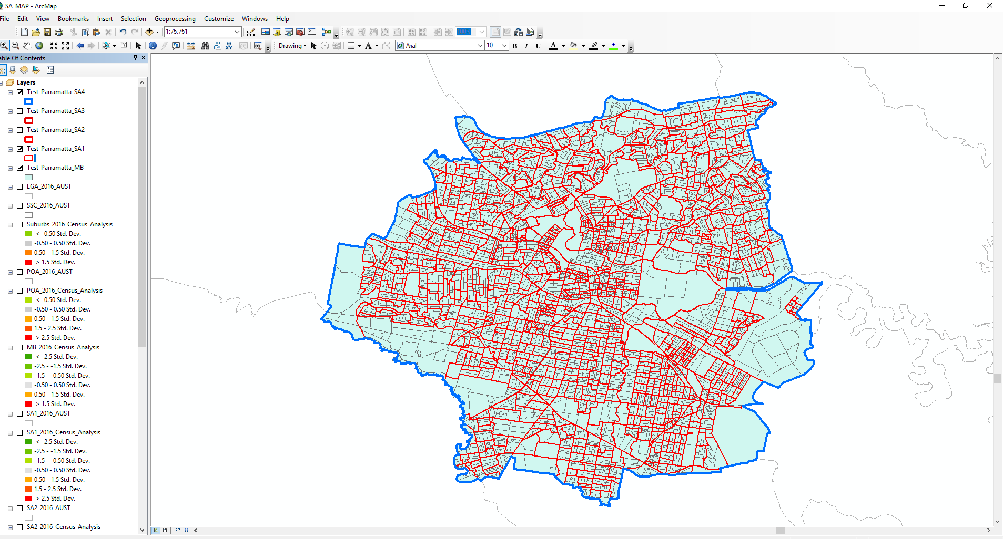
These are the MB’s in the SA4 of Sydney - Parramatta
Meshblock’s
(grey - within SA1’s)
SA4 boundary
SA1 boundary
(red)

